Slide 1

Eukaryotic and Organelle Genomes
Prepared by
Dr. Rawa Abdul Redha Aziz
Ph.D Antibiotics/ Molecular biology
Dr. Hiba Shakir Ahmed
Ph.D Microbiology/Immunity

Slide 2
The eukaryotic genome is larger and more complex than the prokaryotic genome
Eukaryotes have several separate, linear chromosomes.
Each eukaryotic chromosome has a single, continuous, double helix of DNA.
Each chromosome must have recognition sequences, a centromeric sequence, and, on the ends, telomeric sequences.

Slide 3
In eukaryotes, chromosomes are separated from the cytoplasm by the nuclear envelope.
DNA duplication and RNA synthesis occur in the nucleus.
RNA translation occurs exclusively outside the nucleus.
Even within genes there are sequences that are not translated.
Some of these nontranscribed regions are structural, such as the telomeres; some regulate gene expression; and some have no known use.

Slide 4
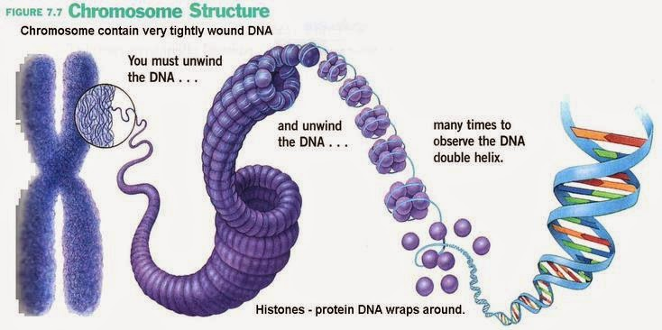

Slide 5
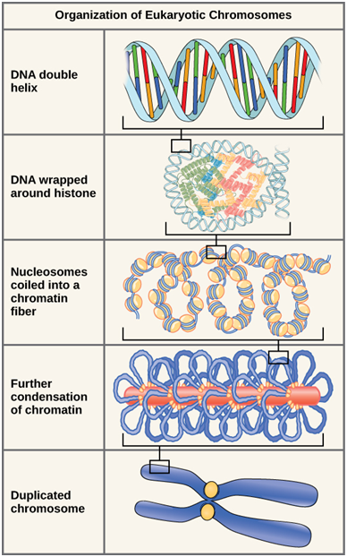

Slide 6
Human Genome Statistics
3.3 billion base pairs in the haploid genome
20,000ish genes
Average of 3000 nucleotides/gene.
Chromosome 1 has the most genes (2968), and the Y chromosome has the fewest (231)
Almost all (99.9%) nucleotide bases are exactly the same in all people

Slide 7
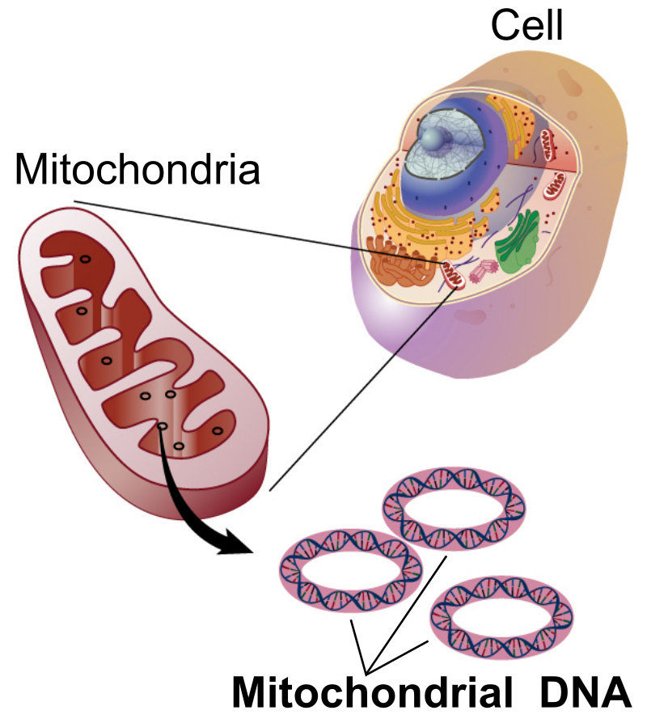
Mitochondrial DNA
Mitochondrial DNA is a small portion of the DNA that is located in mitochondria, cellular organelles within eukaryotic cells. In humans, the 16,569 base pairs of mitochondrial DNA encode for only 37 genes. Human mitochondrial DNA was the first significant part of the human genome to be sequenced. In most species, including humans, mtDNA is inherited solely from the mother.

Slide 8
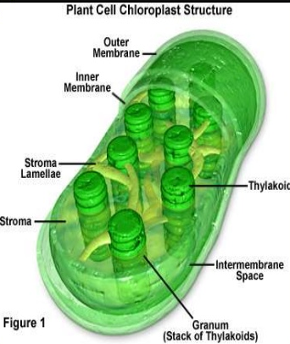
Plastids genome (chloroplast)
Plastids possess their own genome, the plastome, and a specific machinery to decode its genetic information. The first evidence for the presence of heritable material in plastids was reported at the beginning of the last century. More than 50 years later, specific plastid-localized DNA was identified.

Slide 9
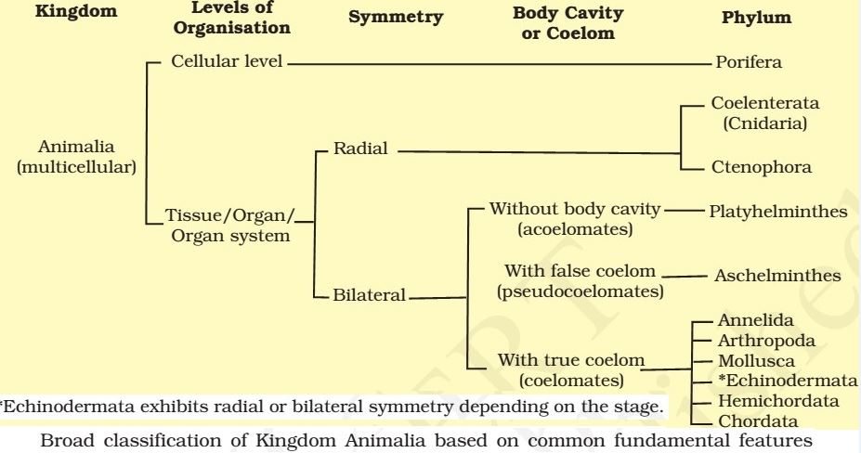
Classification of Animal Kingdom
All members of Animalia are multicellular and do not exhibit the same pattern of organization of cells.

Slide 10
For example
In sponges, the cells are arranged as loose cell aggregates, i.e., they exhibit cellular level of organization.
In coelenterates, the arrangement of cells is more complex.
Organ level of organization is exhibited by members of Platyhelminthes and other higher phyla where tissues are grouped together to form organs, each specialized for a particular function.
In animals like Annelids, Arthropods, Molluscs, Echinoderms and Chordates, organs have associated to form functional systems, each system concerned with a specific physiological function. This pattern is called organ system level of organization.

Slide 11
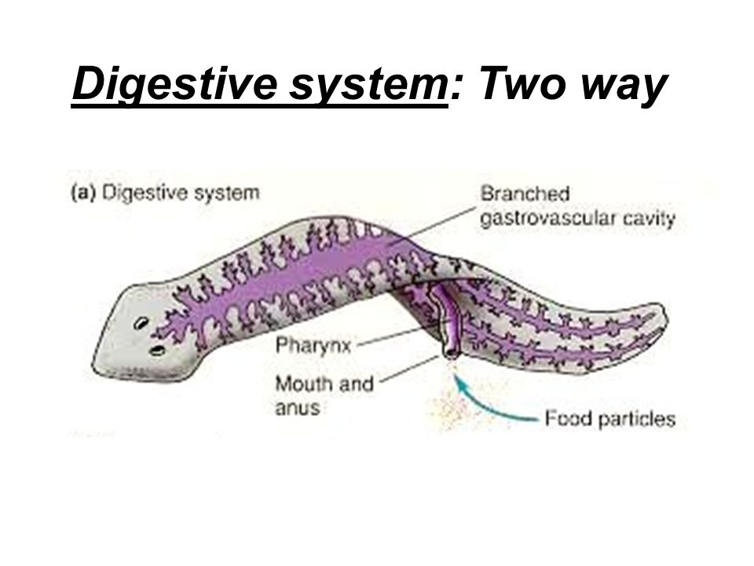
Organ systems in different groups of animals exhibit various patterns of complexities.
For example:
The digestive system in Platyhelminthes (incomplete digestive system) has only a single opening to the outside of the body that serves as both mouth and anus, and is hence called incomplete. A complete digestive system has two openings, mouth and anus.

Slide 12
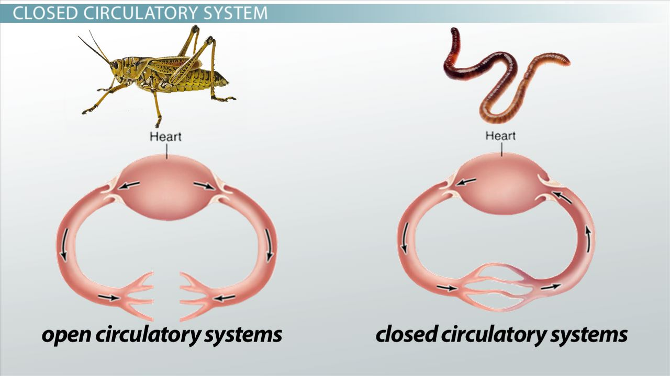
Similarly, the circulatory system may be of two types: open type in which the blood is pumped out of the heart and the cells and tissues are directly bathed in it and closed type in which the blood is circulated through a series of vessels of varying diameters (arteries, veins and capillaries).

Slide 13
Therefore the basis for animal kingdom classification are:
-Levels of Organisation,
-Symmetry,
-Diploblastic and Triploblastic Organisation,
-Coelom development,
-Segmentation of the body and
-Presence or absence of Notochord

Slide 14
Symmetry
Animals can be categorized on the basis of their symmetry.
Sponges are mostly asymmetrical, i.e., any plane that passes through the centre does not divide them into equal halves.
When any plane passing through the central axis of the body divides the organism into two identical halves, it is called radial symmetry. Coelenterates, Ctenophores and Echinoderms have this kind of body plan.
Animals like Annelids, Arthropods, etc., where the body can be divided into identical left and right halves in only one plane, exhibit bilateral symmetry.

Slide 15
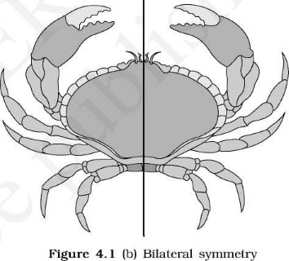
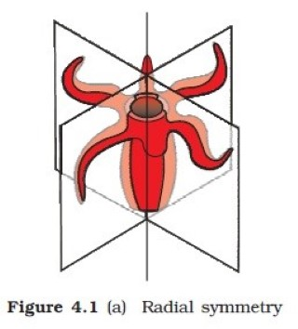
Bilateral Symmetry
Radial Symmetry

Slide 16
Diploblastic and Triploblastic Organization
Animals in which the cells are arranged in two embryonic layers, an external ectoderm and an internal endoderm, are called diploblastic animals, e.g., Coelenterates. An undifferentiated layer, mesoglea, is present in between the ectoderm and the endoderm.
Those animals in which the developing embryo has a third germinal layer, mesoderm, in between the ectoderm and endoderm, are called triploblastic animals (platyhelminthes to chordates).

Slide 17
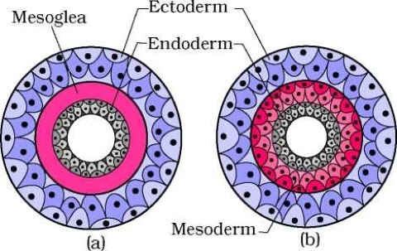
Figure: Showing germinal layers: (a) Diploblastic (b) Triploblastic

Slide 18
Coelom
Presence or absence of a cavity between the body wall and the gut wall is very important in classification.
The body cavity, which is lined by mesoderm is called coelom.
Animals possessing coelom are called coelomates, e.g., Annelids, Molluscs, Arthropods, Echinoderms, Hemichordates & Chordates.
In some animals, the body cavity is not lined by mesoderm, instead, the mesoderm is present as scattered pouches in between the ectoderm and endoderm. Such a body cavity is called pseudocoelom and the animals possessing them are called pseudocoelomates, e.g., Aschelminthes.
The animals in which the body cavity is absent are called acoelomates, e.g., Platyhelminthes.

Slide 19
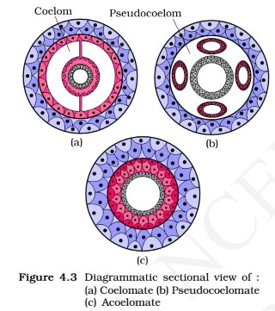

Slide 20
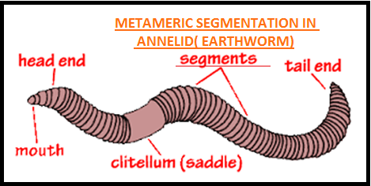
Segmentation
In some animals, the body is externally and internally divided into segments with a serial repetition of at least some organs.
For example, in earthworm, the body shows this pattern called metameric segmentation and the phenomenon is known as metamerism.

Slide 21
Notochord
Notochord is a mesodermally [the middle layer of cells or tissues of an embryo, or the parts derived from this (e.g. cartilage, muscles, and bone)] derived rod-like structure formed on the dorsal side [posterior] during embryonic development in some animals.
Animals with notochord are called chordates and those animals which do not form this structure are called non-chordates, e.g., Porifera to Echinoderms.

Slide 22
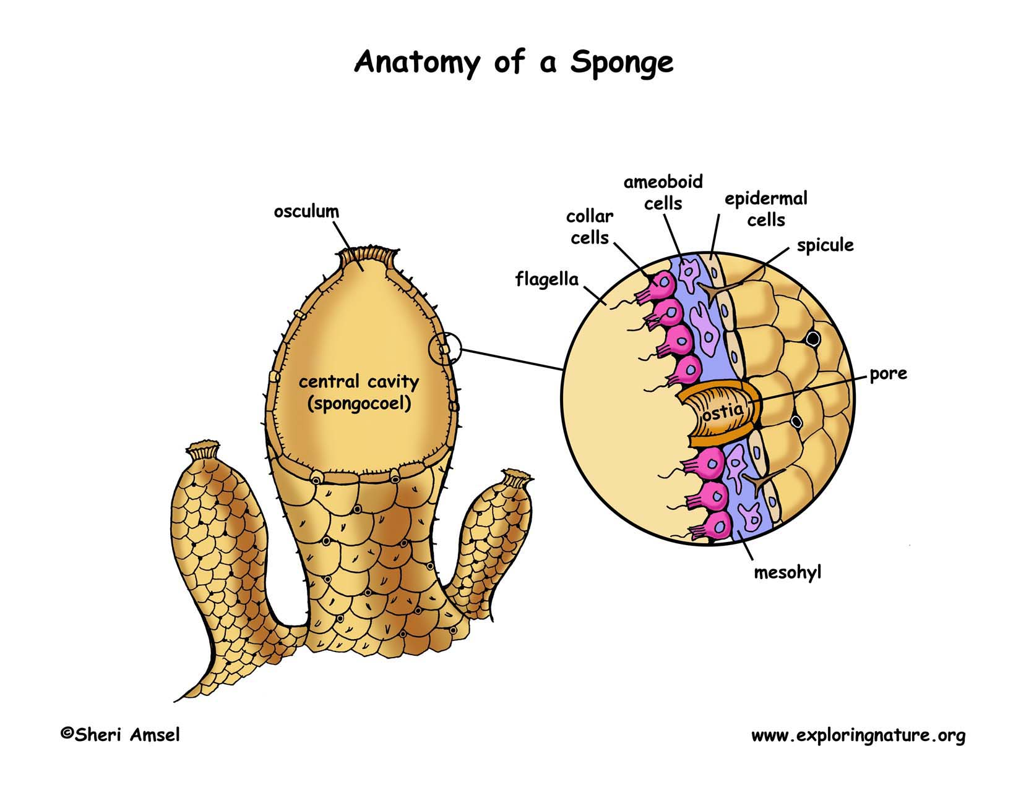

Slide 23

Any Question?

